Slide 1


{ MEAN : Reloaded }
a journey of data
a path for DIGITAL TRANSFORMATION
SMART IoTians-ROUS-TTL-MEAN-Reloaded - Page 1 of 8

Slide 2

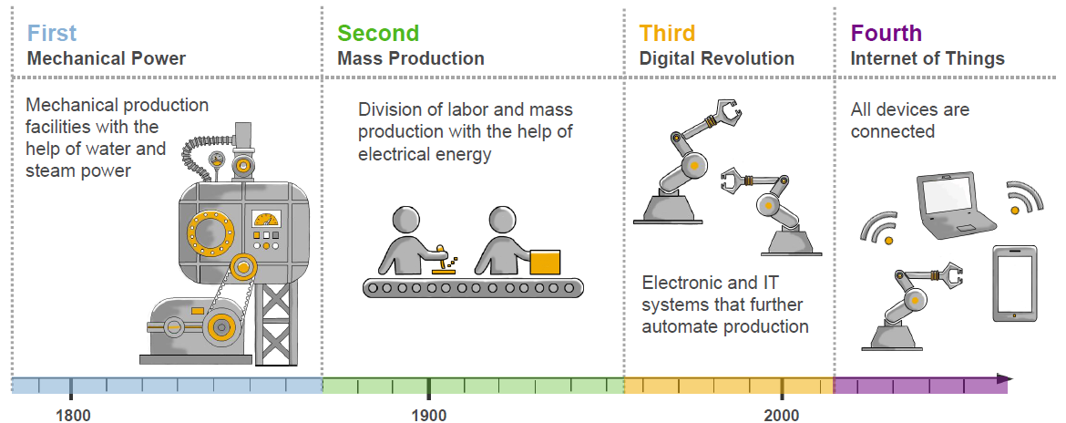

Industrial Revolutions – from Industry 1.0 to 4.0
SMART IoTians-ROUS-TTL-MEAN-Reloaded - Page 2 of 8

Slide 3
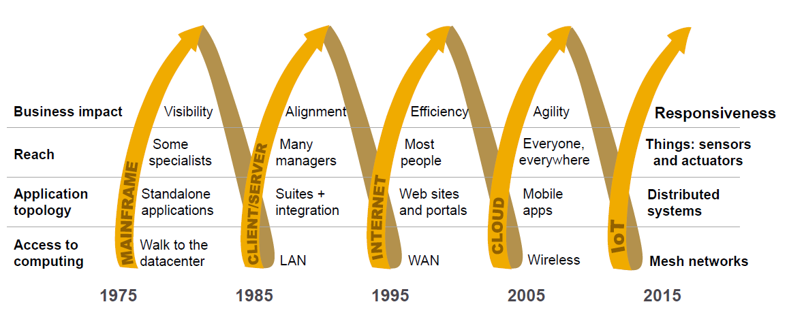





Technology Reshapes Business
BIG
Data
IoT
Data
SMART IoTians-ROUS-TTL-MEAN-Reloaded - Page 3 of 8

Slide 4
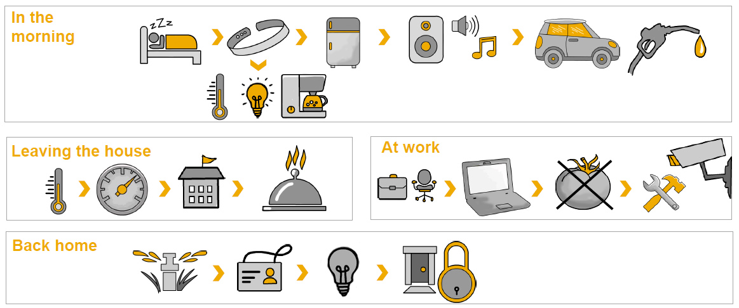

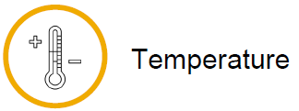


The IoT world today – let’s imagine a “normal” day
Sensor
measurement
examples
SMART IoTians-ROUS-TTL-MEAN-Reloaded - Page 4 of 8

Slide 5
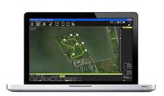












IoT 2.0 : Edge Computing – Interaction with the physical world
(topic, message)
(topic, message)
MQTT
publish
subscribe
(topic, message)
publish
(topic, message)
subscribe
SMART IoTians-ROUS-TTL-MEAN-Reloaded - Page 5 of 8

Slide 6
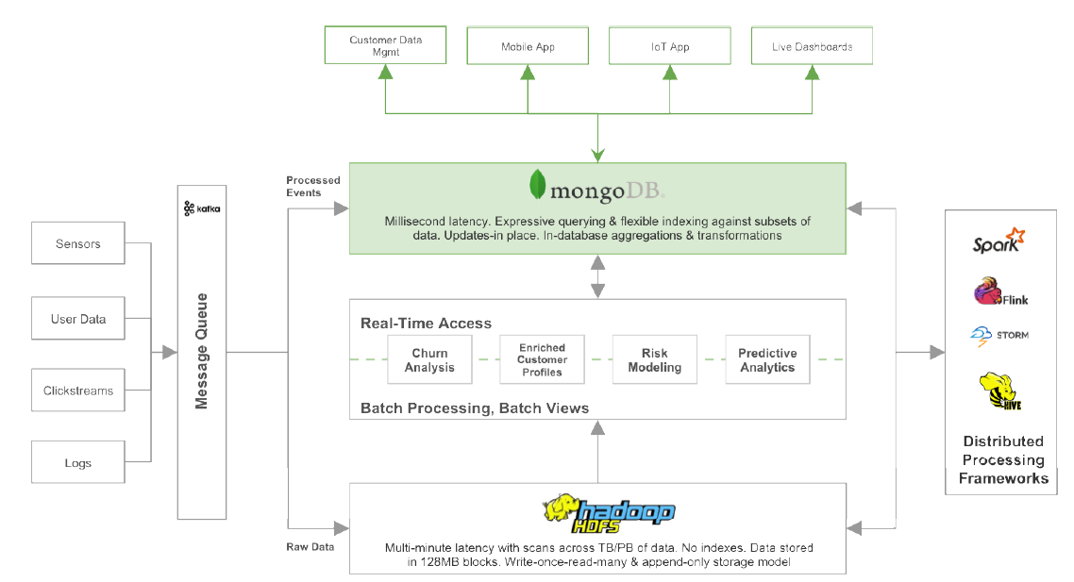
Unlocking Operational Intelligence from the Data Lake
SMART IoTians-ROUS-TTL-MEAN-Reloaded - Page 6 of 8

Slide 7
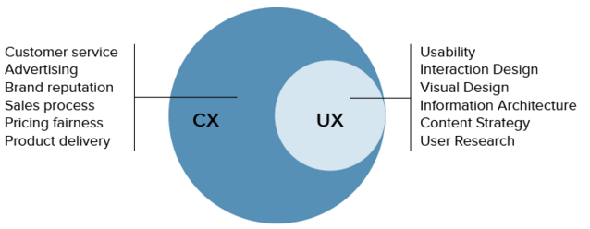
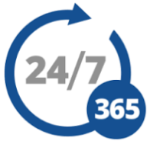


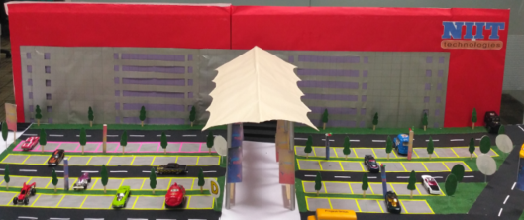

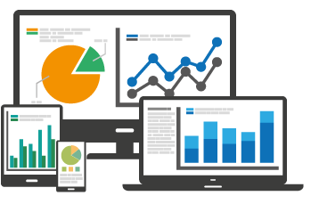

Customer eXperience / User eXperience
SERVICES
LATEST TECHNOLOGIES
PROTOTYPES
SOCIAL SUPPORT
ANALYTICS
QUALTIY
SMART IoTians-ROUS-TTL-MEAN-Reloaded - Page 7 of 8

Slide 8
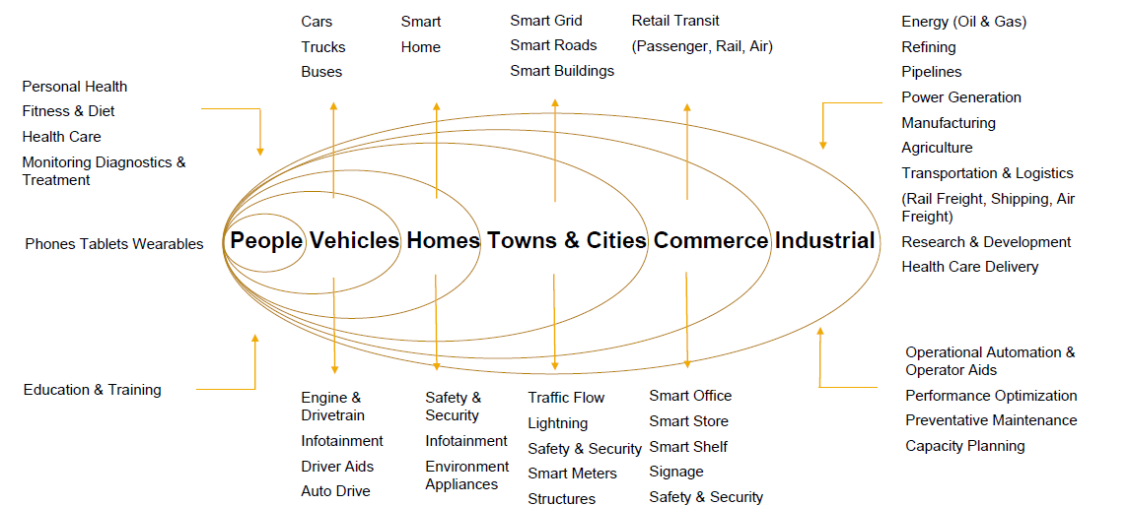
Digital Transformation – A new beginning of IT era
IoT
2.0
Biometric Sensors Biometric Identification Technology Wearable Technology and Application
Brain Informatics Sensing and Processing Body Area Network (BAN) technology and services
Social Computing and Collective Intelligence Network Internet of Brain Intelligence and Creation Security and Privacy Human Body signal collection, processing and communication theory
IoP
SMART IoTians-ROUS-TTL-MEAN-Reloaded - Page 8 of 8

